Slide 1

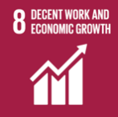
Decent work and economic growth
Today, Zhetysu University named after Ilyas Zhansugurov is the only higher educational institution in the field of Zhetysu that provides three-level personnel training taking into account the needs of the regional labor market.
Within the framework of the Mamandygym–Bolashagym Roadmap, the university team, based on foresight research, is working to develop a regional map of personnel needs and an Atlas of new professions in the Zhetysu region (in the areas of education, agriculture, information and communication technologies, tourism)
The Department of Career and Employment is working to determine the need for specialists in the field of Zhetisu, the implementation of assistance in ensuring the employment of university graduates.
НАЗВАНИЕ СЛАЙДА

